Slide 1



EIES
ASP.NET core Workshop
EIES
2023

Slide 2
EIES
Web Application Architecture​
ORM (Object-Relational Mapping)​
Entity Framework​
ASP.NET Web APIs
User registration​
User Login​
Authentication​
Authorization​
JWT (JSON Web Tokens)​
CORS handling
Plan

Slide 3
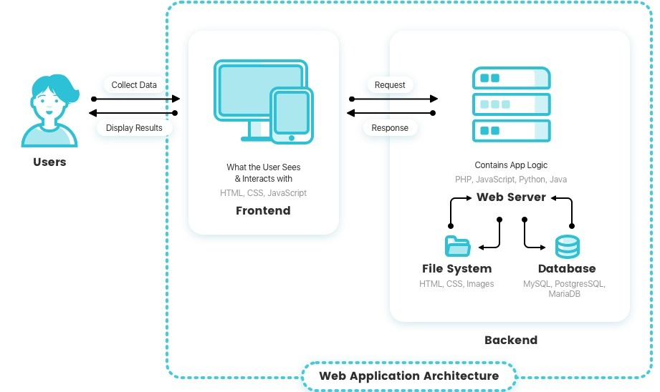

Web App Architecture
EIES

Slide 4
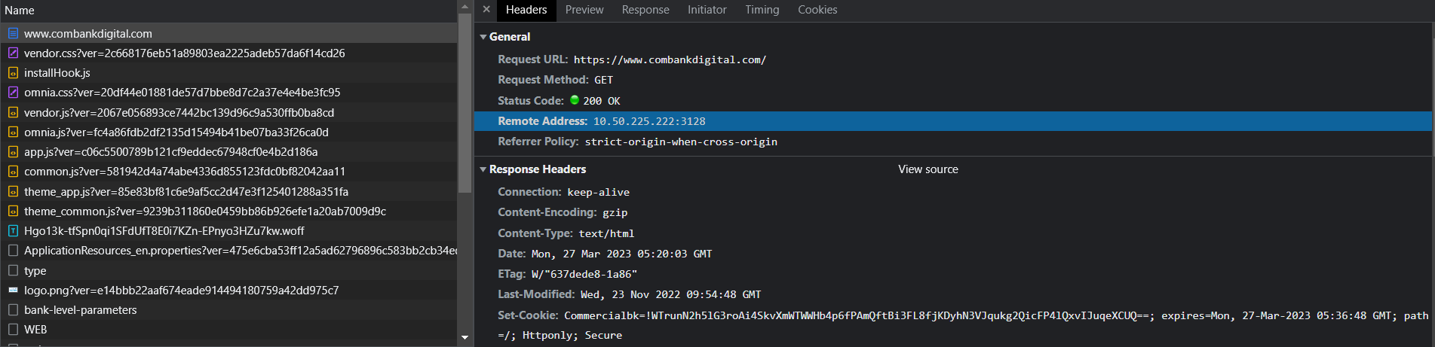
Hypertext transfer protocol (HTTP)
EIES

Slide 5
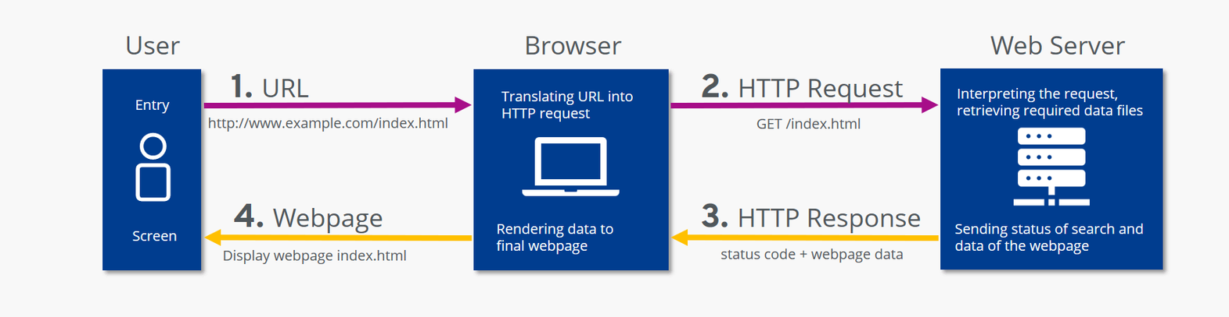
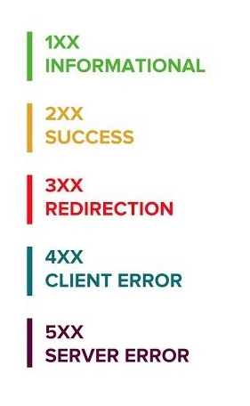
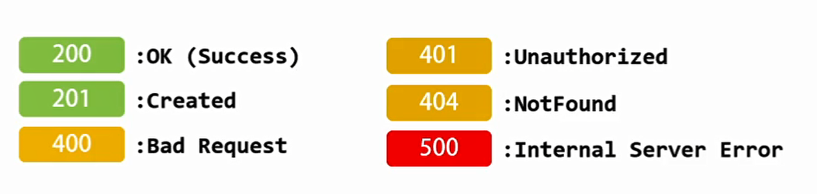
Hypertext transfer protocol (HTTP)
EIES
HTTP Status Codes

Slide 6
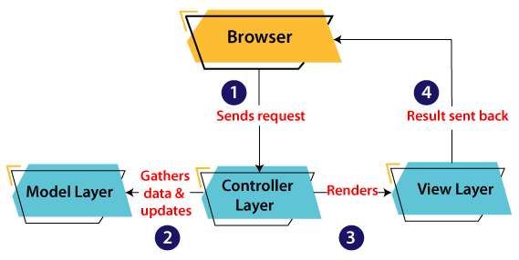
MVC Architecture
EIES

Slide 7
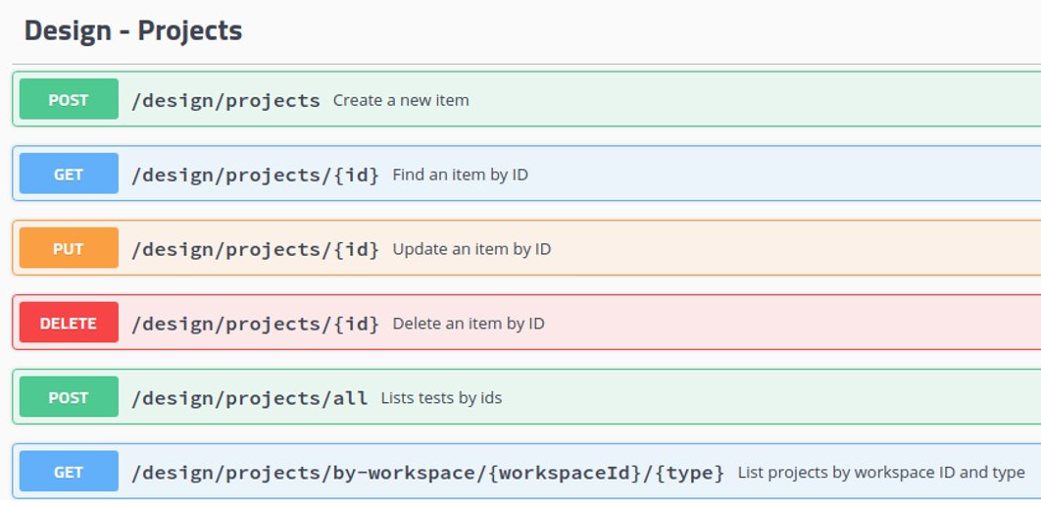
Backend - API Endpoints
EIES

Slide 8
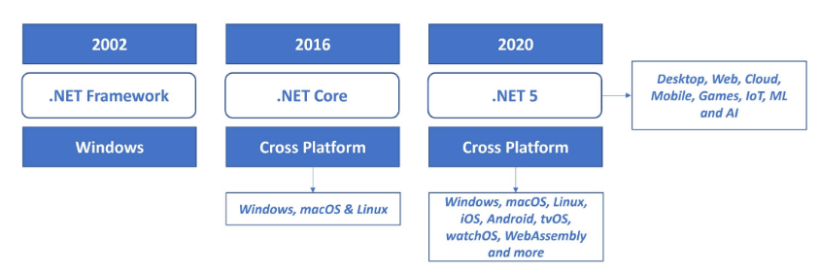
ASP.NET
EIES

Slide 9





Backend Technologies
EIES
PHP
JavaScript
Python
C#
JAVA

Slide 10
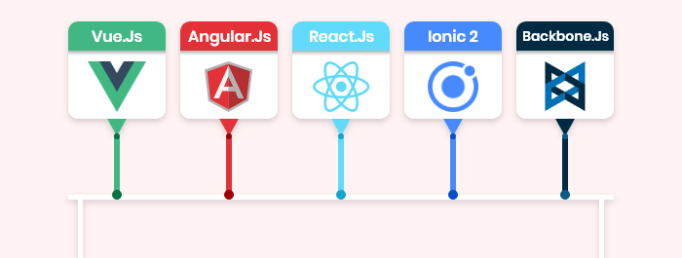
Frontend Technologies
EIES
JavaScript

Slide 11
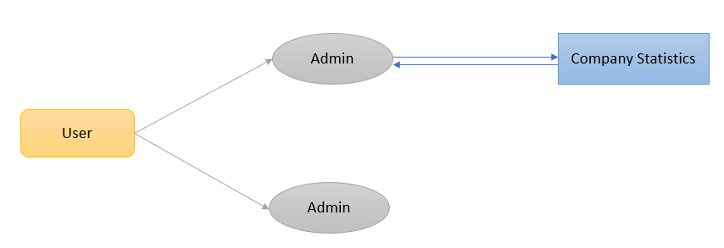
Demo Case
EIES
Customer

Slide 12
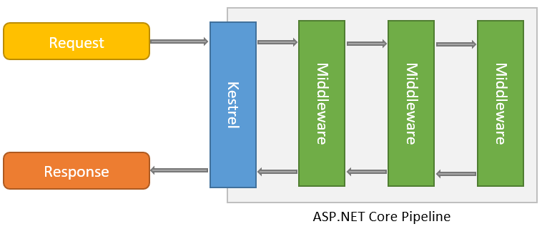
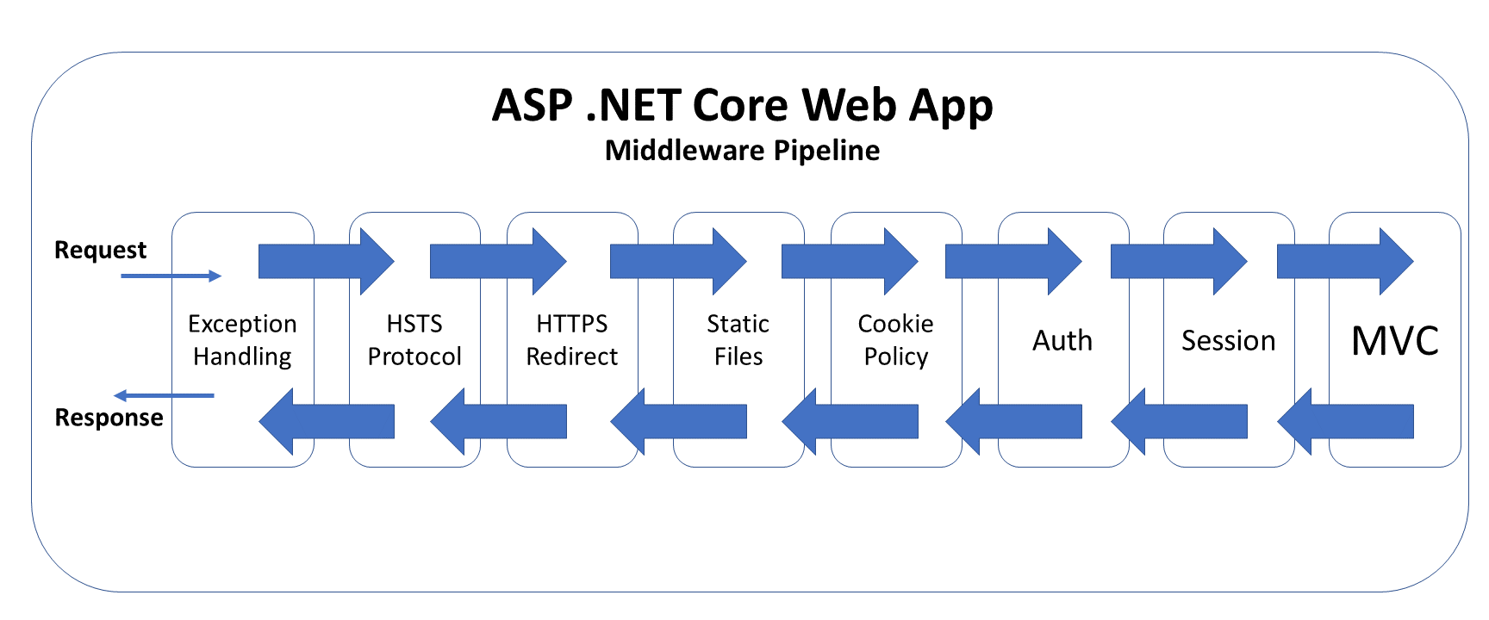
ASP.NET - Middleware Pipeline
EIES

Slide 13
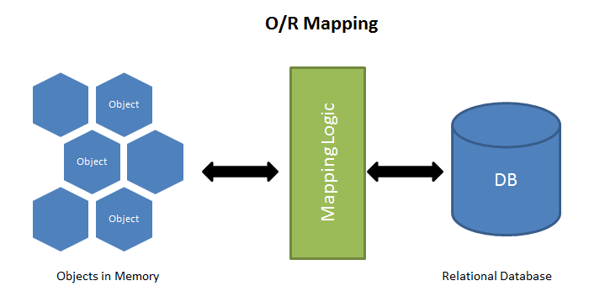
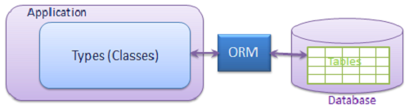
Object-Relational Mapping (ORM)
EIES

Slide 14
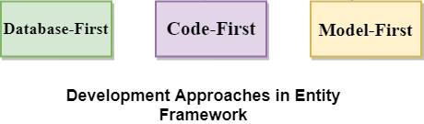
Entity Framework core(EF core)
EIES
Manages DB Connections
No SQL syntax
Allow quick switch of different Database Engines
IntelliSense
Create/Change Database and tables
Migrations
Different Approaches

Slide 15


Package Managers
EIES
Automates software installation, updates, configuration, and removal
Simplify software management
Manage dependencies
Python Package Index (PyPI))

Slide 16
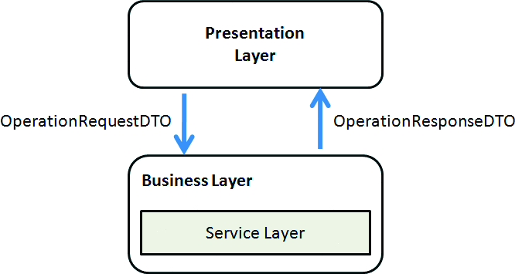
DTOs
EIES

Slide 17
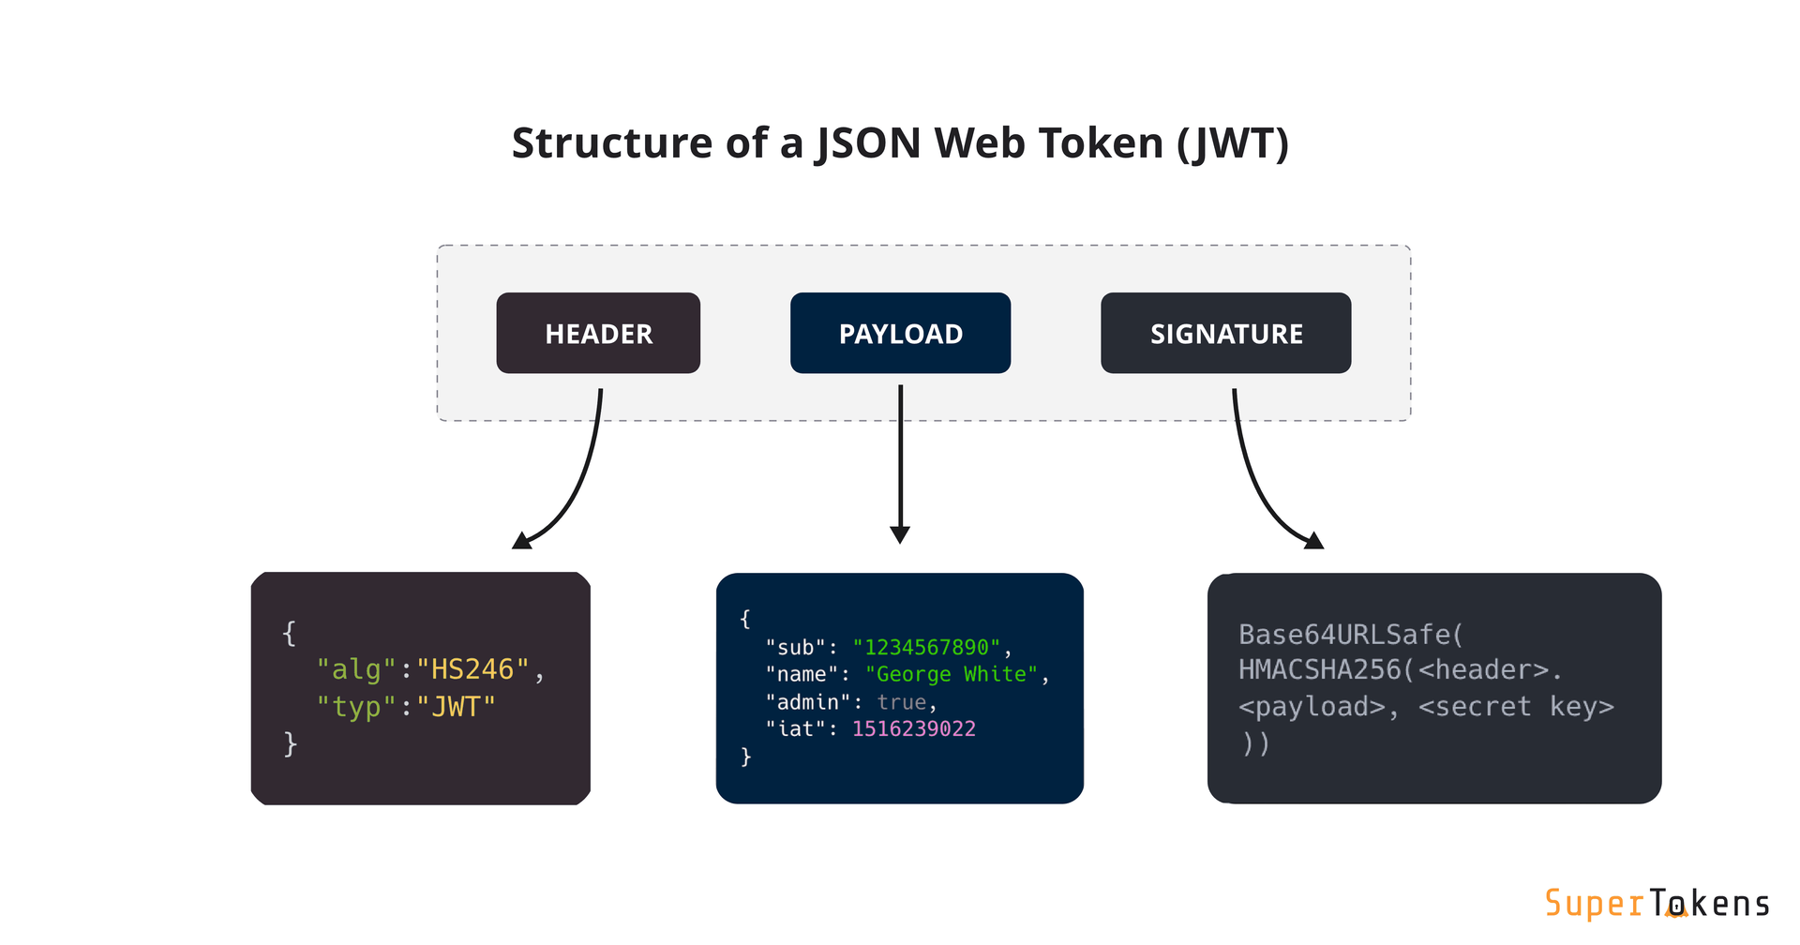
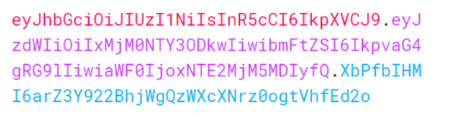
Json Web Token (JWT)
EIES
https://jwt.io/

Slide 18
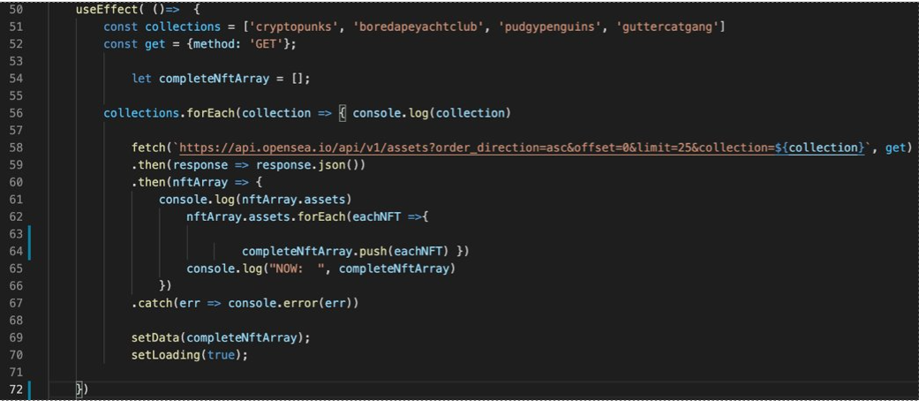
Frontend - API Call
EIES

Slide 19
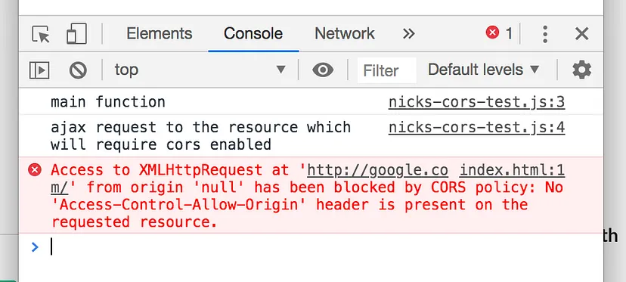
Cross Origin Resource Sharing (CORS)
EIES
Security feature to control which websites can access resources
Browser sends HTTP request with "Origin" header, server responds with "Access-Control-Allow-Origin" header
Prevents unauthorized access
Enhances web app security

Slide 20
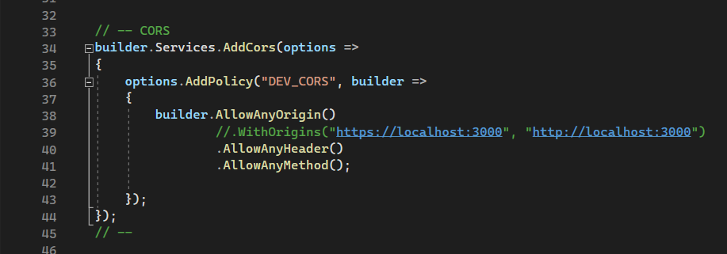
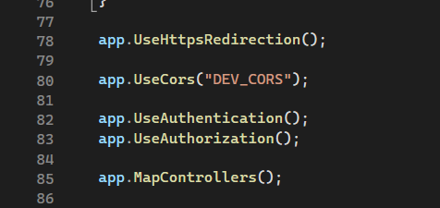
Handling CORS
EIES
program.cs
Order Matters

Slide 21
Note: Authentication (missed in workshop)
EIES
After all configurations, below snippet should be added being concerned of the order
Order Matters

Slide 22
EIES
Thank You !

